Slide 1



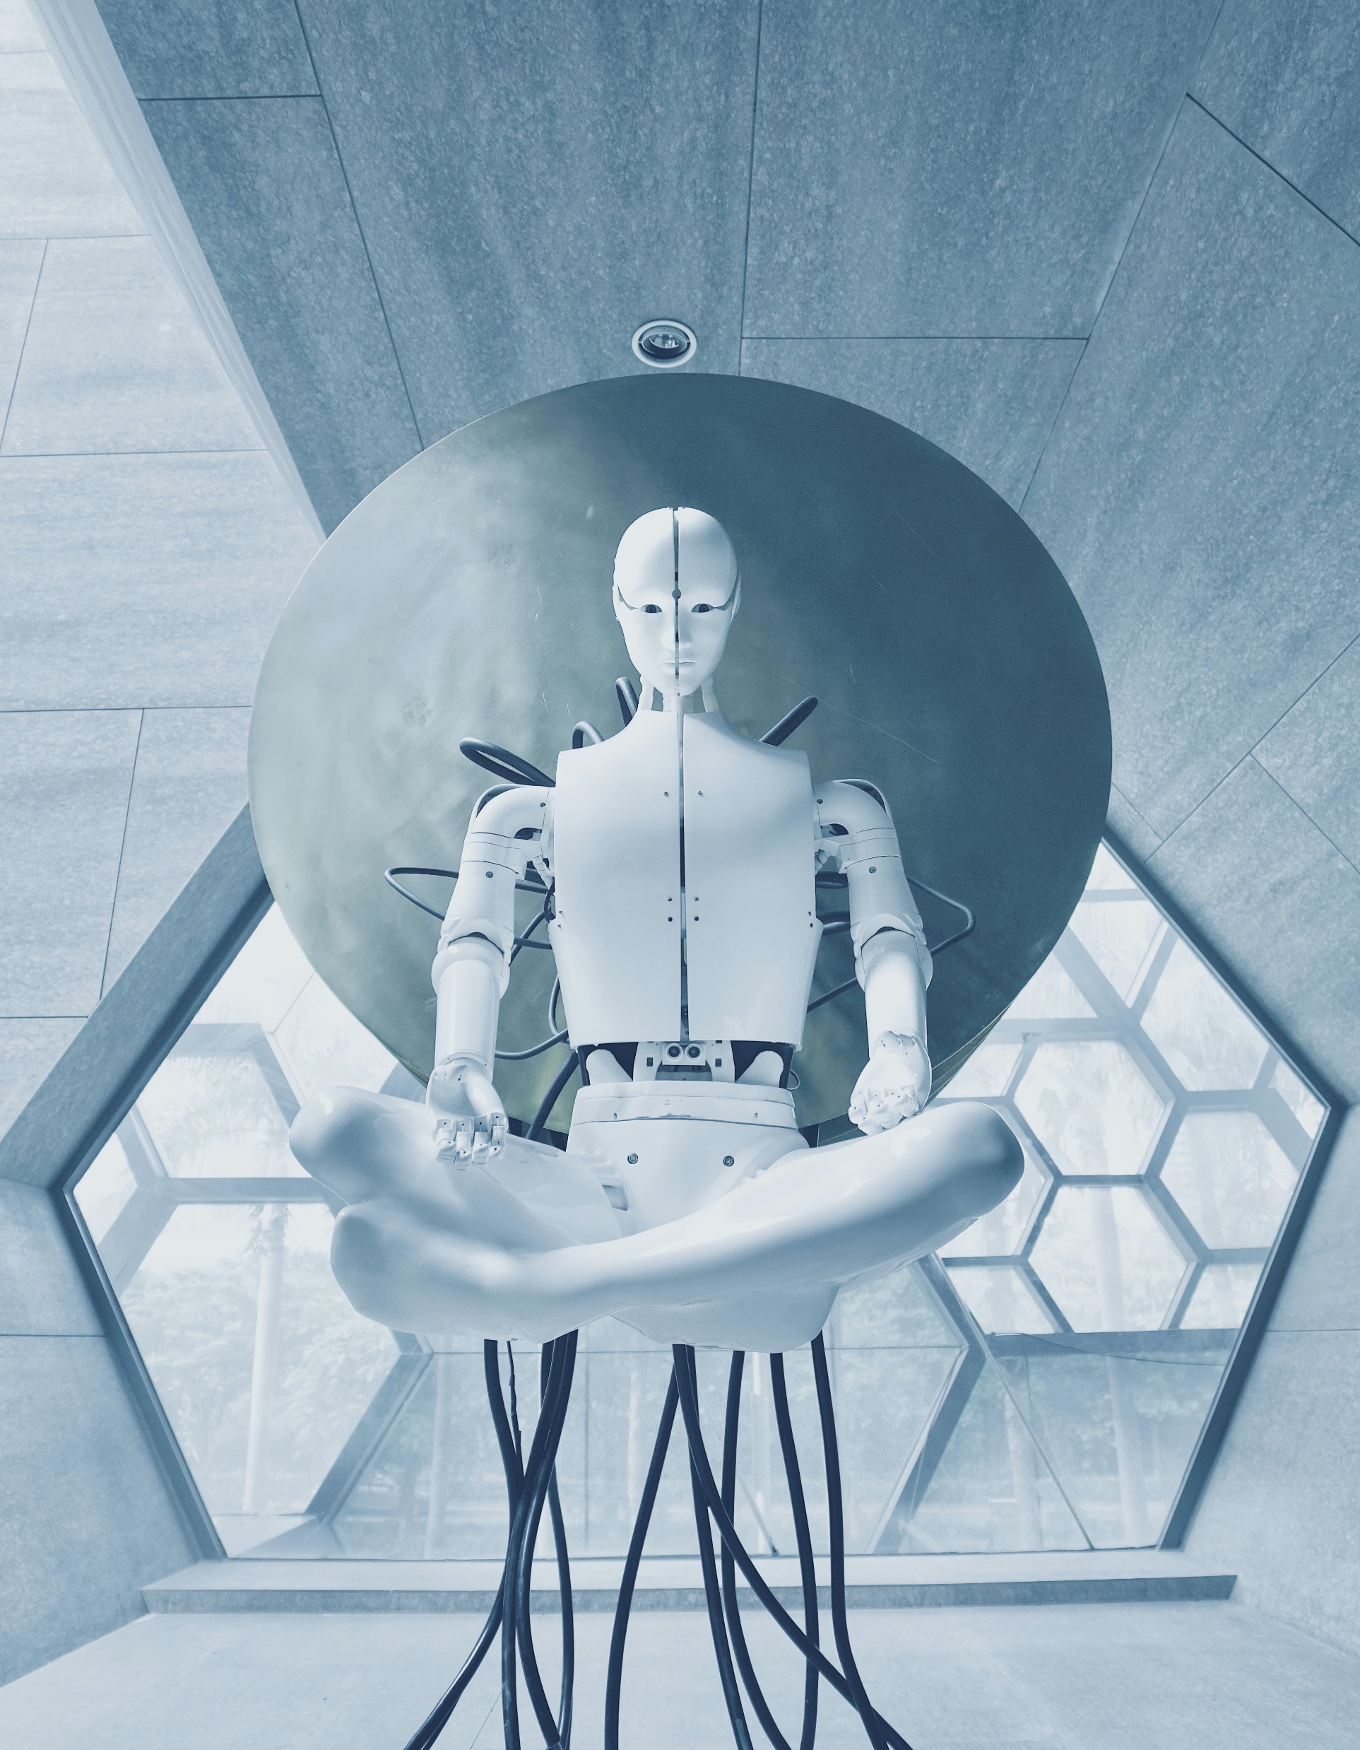
Code Sensei
COMP-4500
Group Members: Zainab Latif, Hamza Baig, Ameya Ade, and Abhishek Yawalkar
Project Webpage - latifz.github.io
Notes:
Reference: Photo by Aideal Hwa on Unsplash

Slide 2

Storyboard

Slide 3
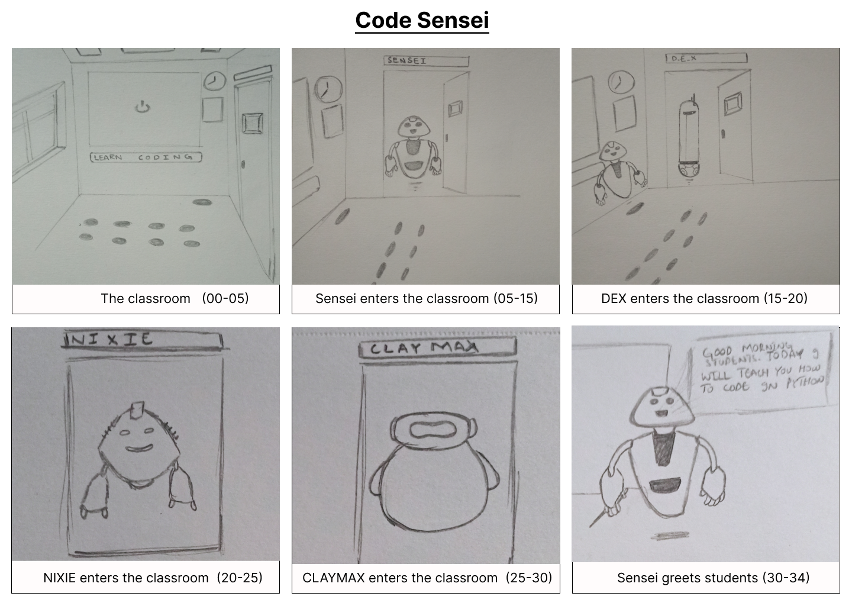
Storyboard…

Slide 4
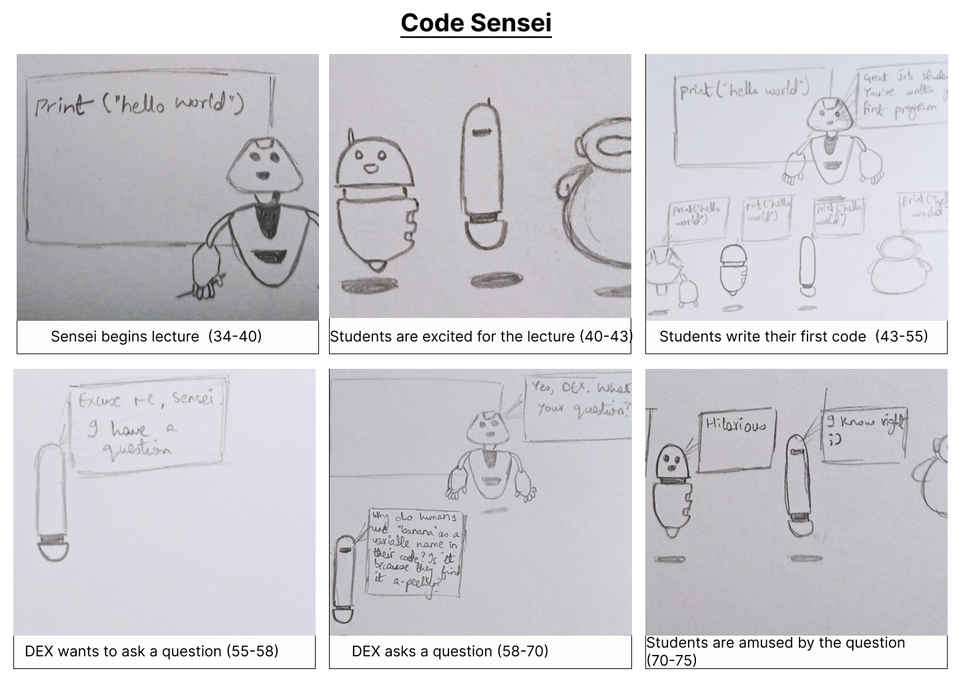

Slide 5
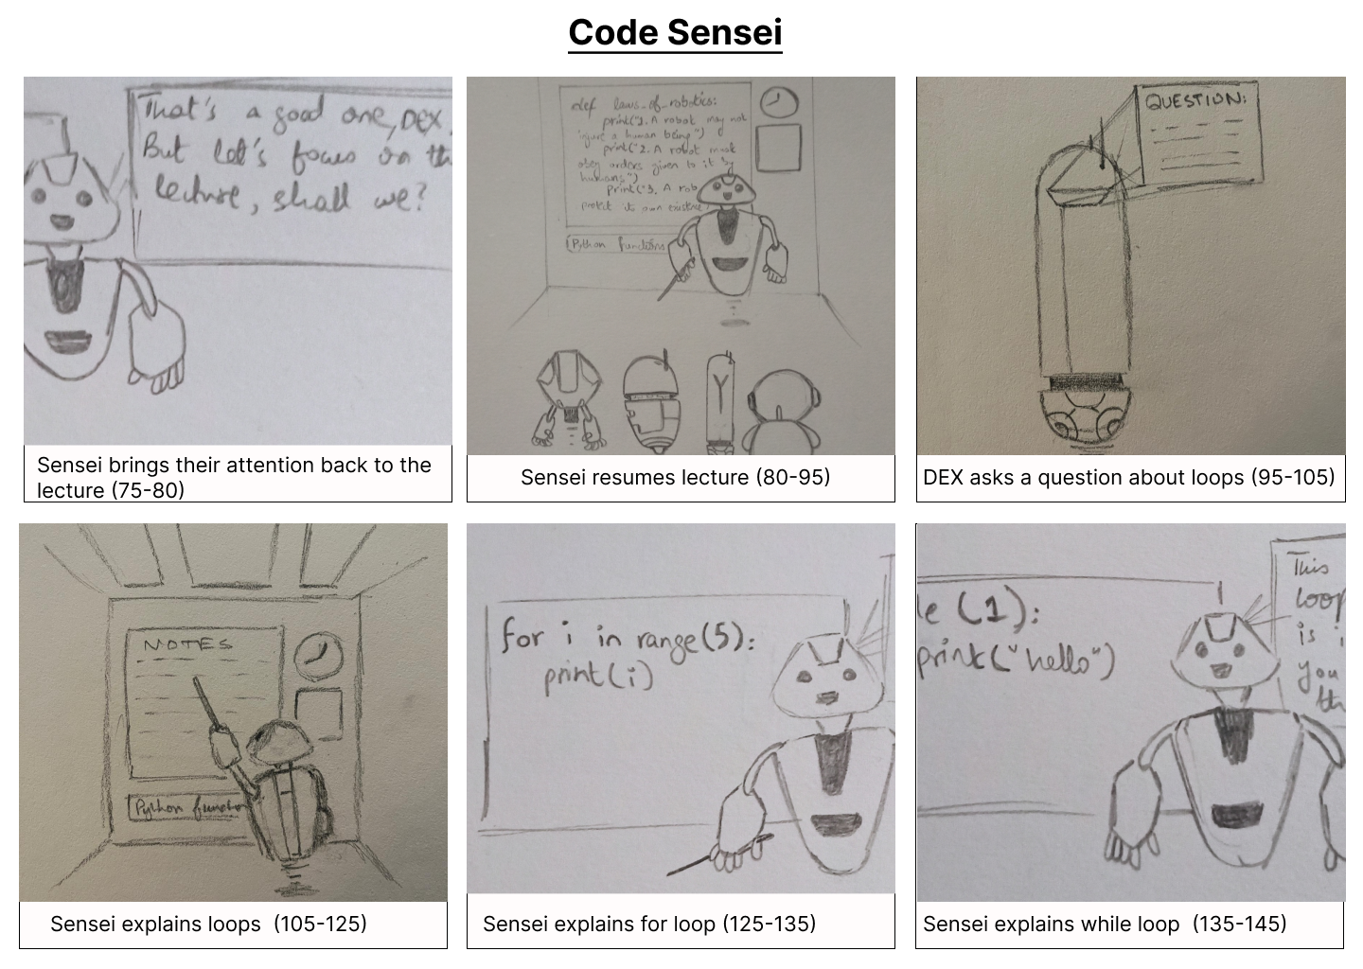

Slide 6
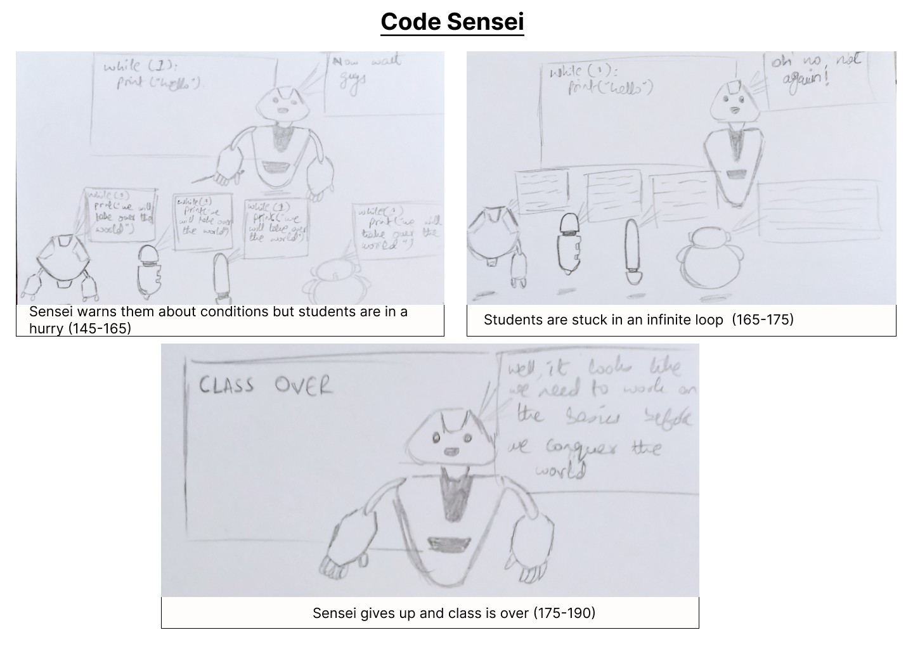

Slide 7
Tasks and Timeline
30 Jan.
Final Storyboard
8 Feb.
Modeling Characters
10 Feb.
Modeling Props
20 Mar.
Animation
Review draft
30 Mar.
Final Animation
Designing Characters
Designing Scene
Designing Props
Modelling Scene
Simple Movement Animation
15 Mar.
Script/voiceovers
Notes:
30 Jan.
Final Storyboard
Designing Characters
Designing Scene
Designing Props
8 Feb.
Modeling Characters
Modelling Scene
10 Feb.
Modeling Props
Simple Movement Animation
15 Mar.
Script/voiceovers
20 Mar.
Animation
Review draft
30 Mar.
Final Animation

Slide 8

Distribution of Tasks
Creating storyboard - Hamza, Zainab
Updating webpage - Ameya
Design models - one each
Creating models
4 Students - one each
1 Teacher - contribute together
Creating scenes
Classroom (room, lighting) - Ameya, Abhishek
Creating props
board/projector to display slides – Zainab
Pointer to go over the slides - Hamza
Finalizing scripts - Hamza
Voiceover - Abhishek
Animation - contribute together
Notes:
Creating storyboard - Hamza, Zainab
Updating webpage - Ameya
Design models - one each
Creating models
4 Students - one each
1 Teacher - contribute together
Creating scenes
Classroom (room, lighting) - Ameya, Abhishek
Creating props
board/projector to display slides – Zainab
Pointer to go over the slides - Hamza
Finalizing scripts - Hamza
Voiceover - Abhishek
Animation - contribute together

Slide 9
Milestones
15 Feb.
Final storyboard and animation –
Timings will be finalized – including number of frames per scene
Plan out the different camera angles
Basic models of the characters and props should be created
10 Mar.
Final models of all our objects will be completed
10 April.
Audio and the remaining scenes will be added
The final animation will be completed and reviewed for adjustments
60%-70% of the scenes should be fully rendered, including lighting and camera positions
Notes:
Final storyboard and animation –
Timings will be finalized – including number of frames per scene
Plan out the different camera angles
Basic models of the characters and props should be created
Final models of all our objects will be completed
60%-70% of the scenes should be fully rendered, including lighting and camera positions
Audio and the remaining scenes will be added
The final animation will be completed and reviewed for adjustments

Slide 10
MODELS

Slide 11
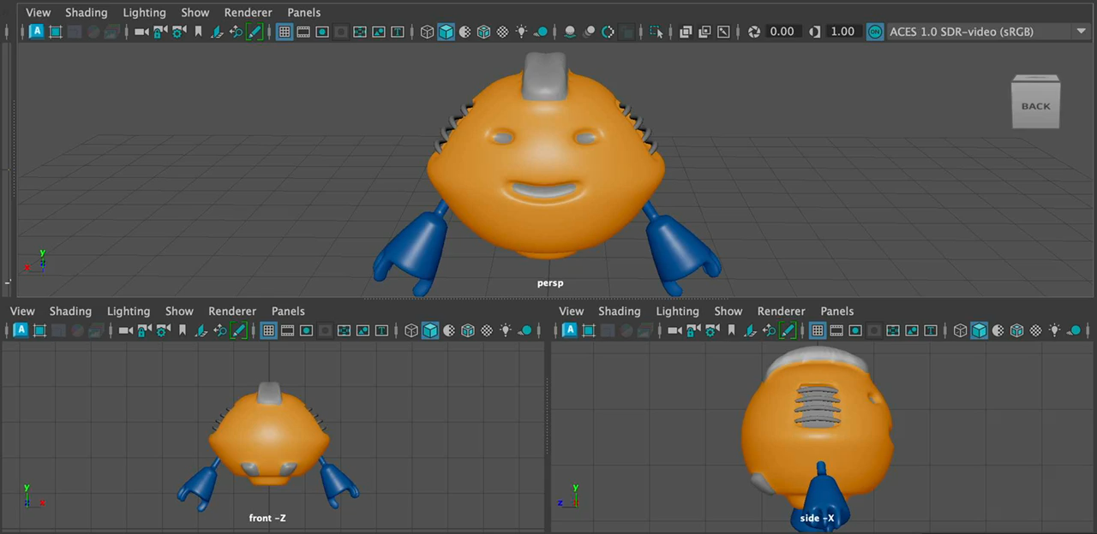
Student
Robot #1

Slide 12
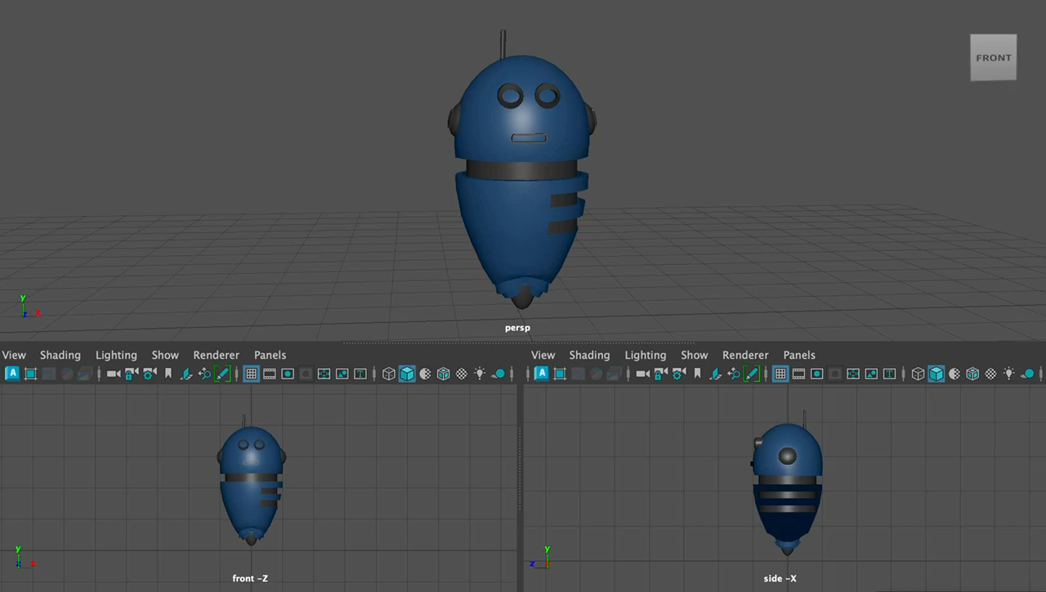
Student
Robot #2

Slide 13
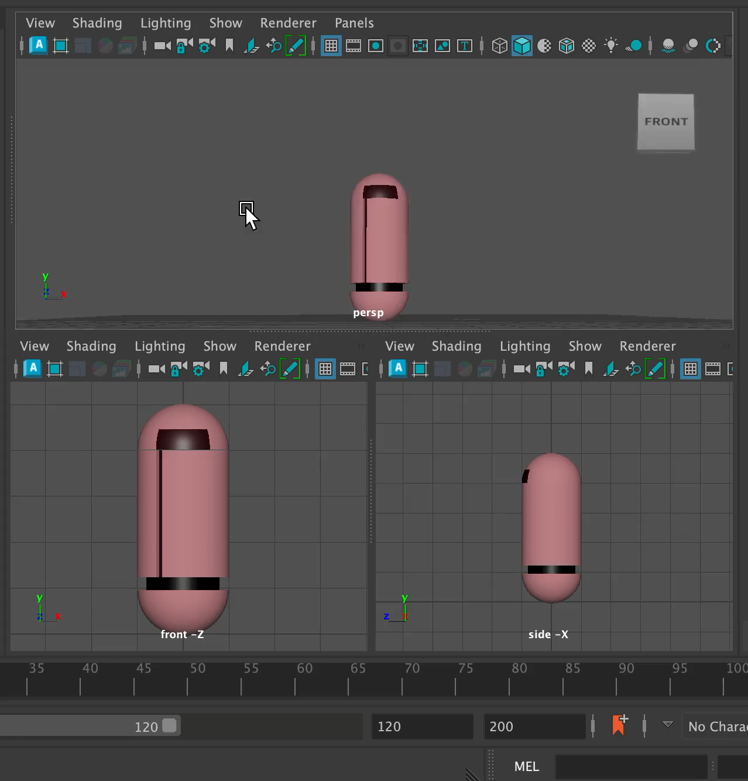
Student
Robot #3

Slide 14
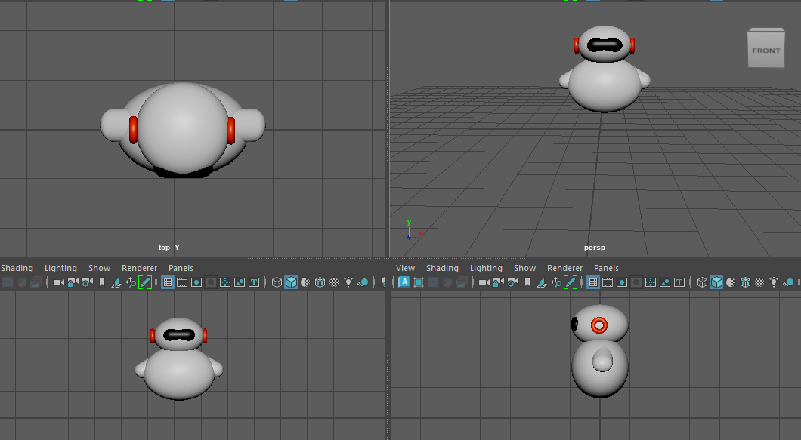
Student
Robot #4

Slide 15
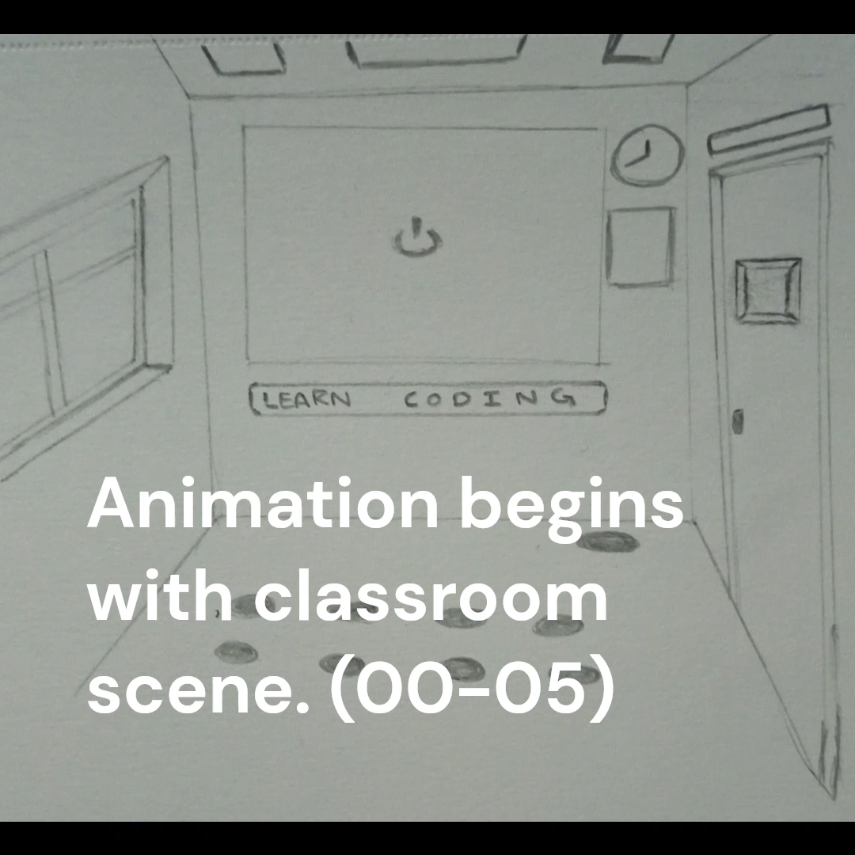
Animatic

Slide 16
Thank You

